Slide 1
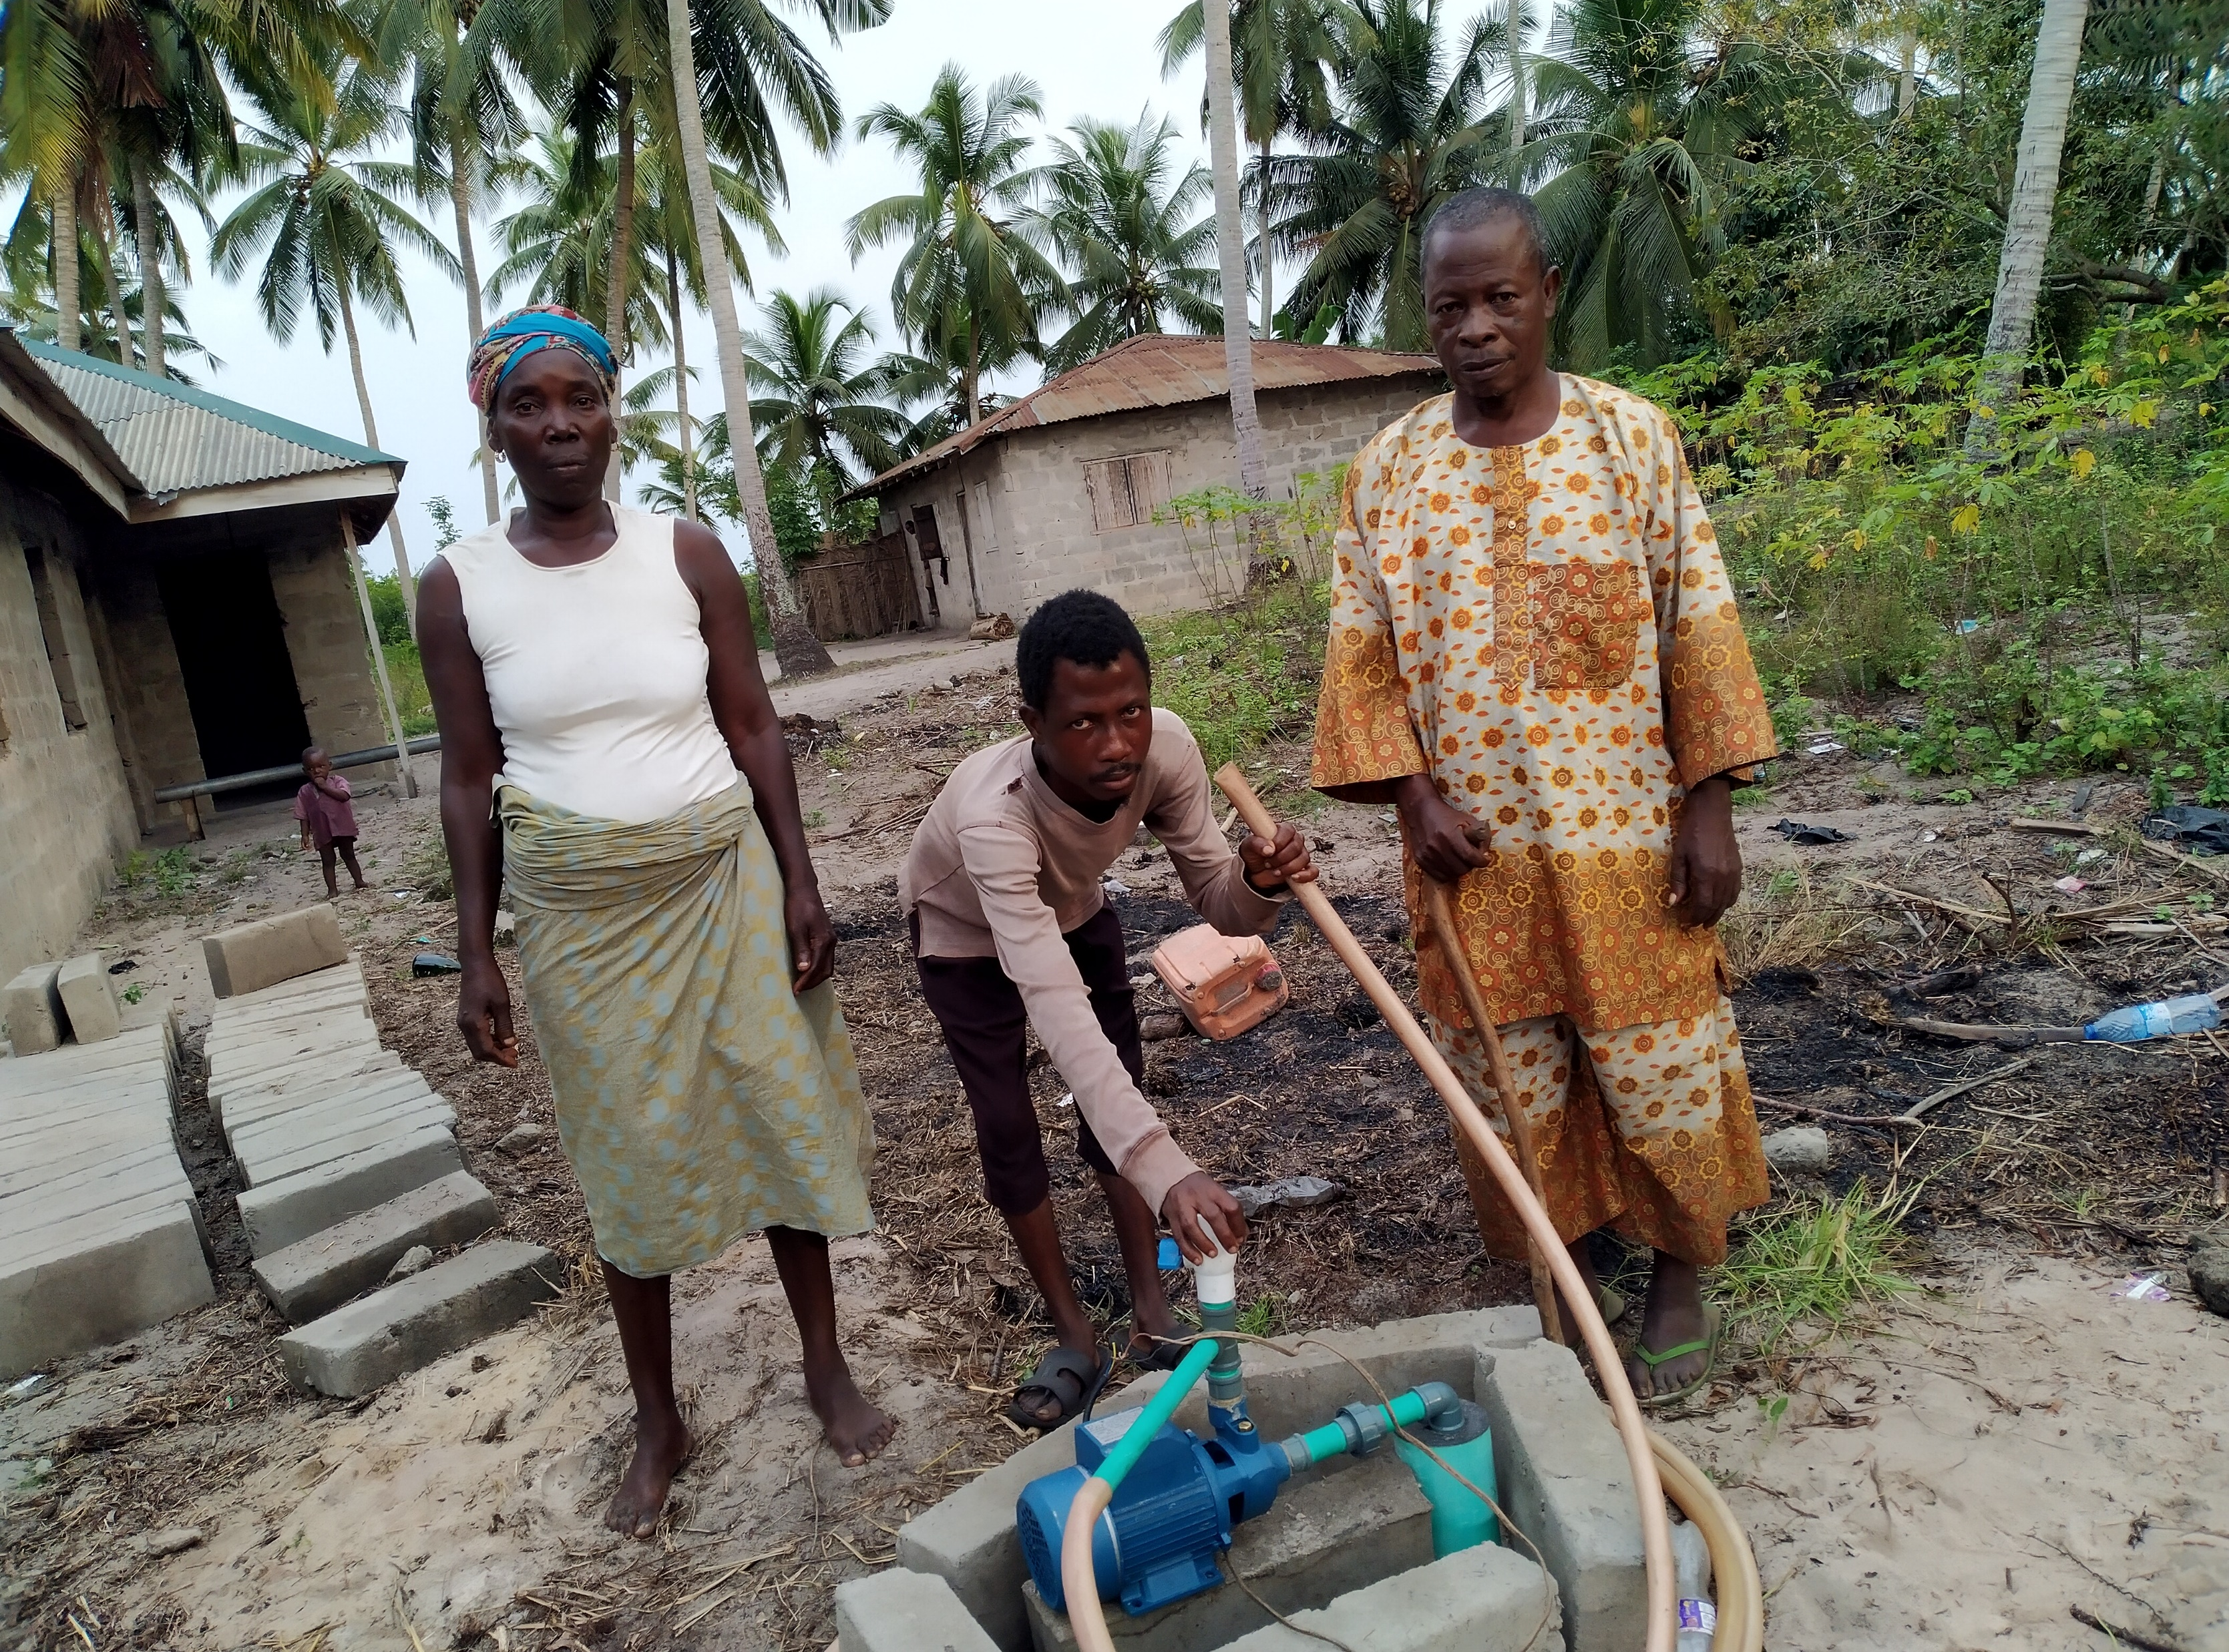
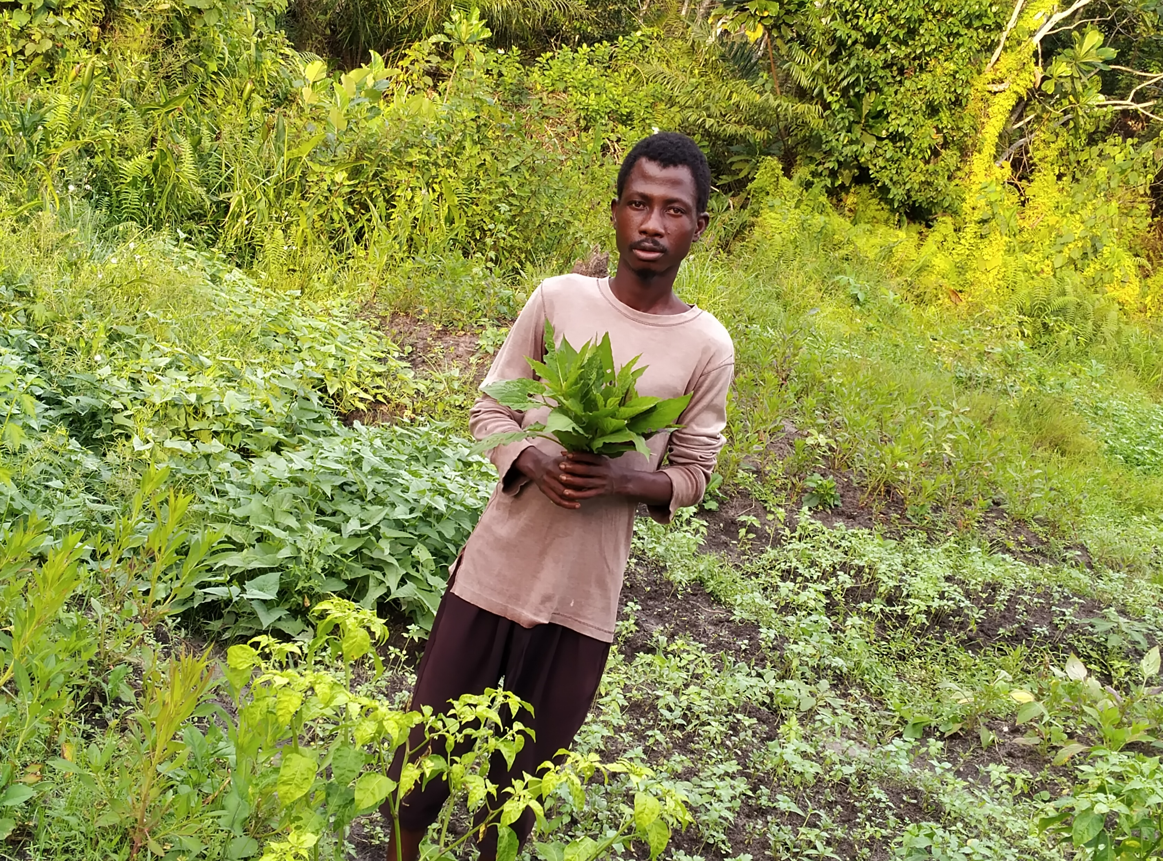
ADOKU MICHAEL
Michael is a 24-year-old youngster with speech impairment. He lives with his parents in Vahanyingbeme community of Badagry. His parents put him in school as well as learning barbing neither of which Michael could cope with. This made the father to engage him in farming (piggery and vegetables cultivation. Through the help of Liliane Foundation, he was supported with borehole, pumping machine to water his vegetable beds, construction of piggery pens with piglets to start his piggery business. Michael feels happy and looks to the future with bright hopes. He and his parents are grateful to Liliane Foundation for setting Michael on the path of independence.

Slide 2
AFOJI MARGARET
Margaret is 18 years old with upper limb deformity. She has received support for education from LF for up to 11 years and awaiting her results. However, due to the financial incapability and poor health of both parents, the youngster decided to learn skill that will enable her make income and sponsor her own education in the nearest future. After the presentation of a new sewing machine, payment of training fee and other accessories through the support of Liliane Foundation, Margaret feels happy and confident to acquire sewing skills and make good income.

